Slide 1
Forest Fire Classification Using Random Forest
Scott Babcock
WGU - MS, Data Analytics

Slide 2
Introduction
Education
Professional
MS, Data Analytics
Western Governors University
Expected Completion: 2025
BBA, Accounting
Boise State University
2014
BA, History
George Fox University
2009
Albertsons Companies
Senior Manager, Real Estate Analytics
2016-2025
CliftonLarsonAllen LLP
Tax & Assurance Associate
2014-2016

Slide 3
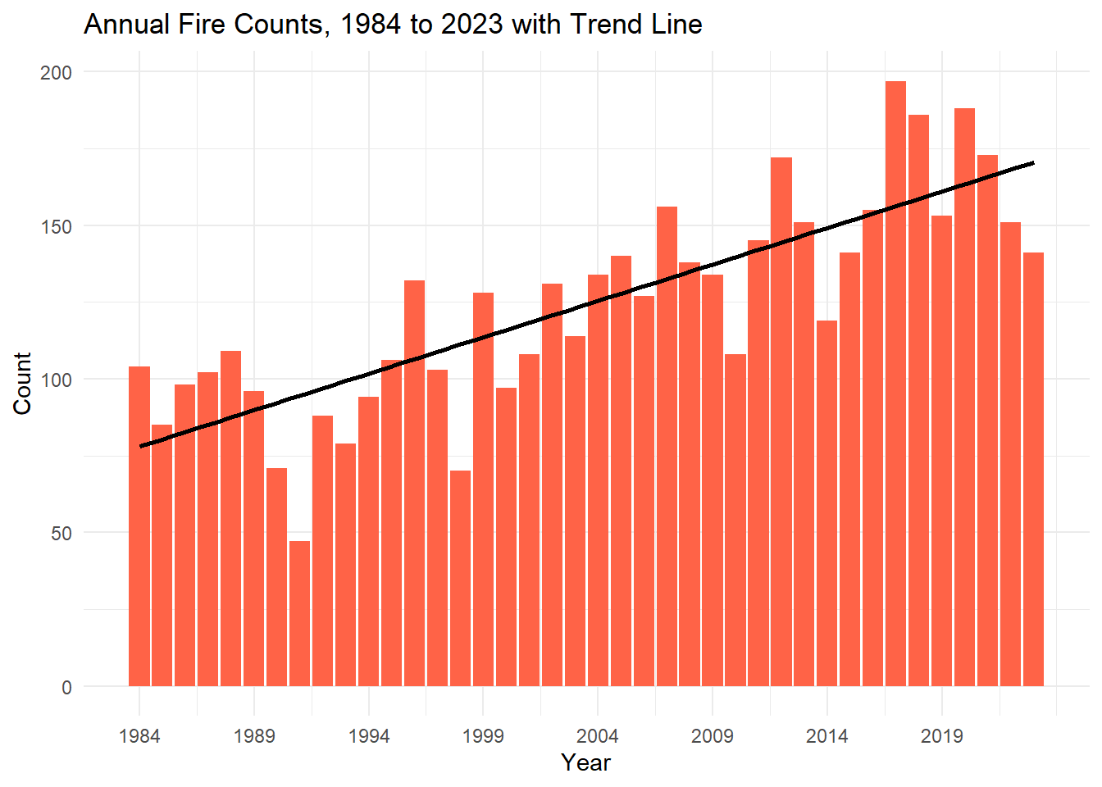
Issue at Hand
Annual cost of wildfires have elevated to $424 billion
Impacts citizens, communities, infrastructure, and wildlife
Wildfire detection has been historically reactive instead of proactive

Slide 4
Research Question & Hypothesis
Research Question
Can environmental conditions be used to accurately predict when a wildfire will occur?
Null Hypothesis (H₀)
Weather features have no predictive power regarding the timing of fire ignition events.
Alternative Hypothesis (H₁)
Weather features have predictive power regarding the timing of fire ignition events.

Slide 5


Data Analytics Process
Data Acquisition
CA Wildfires dataset
1984-2023
R Programming Language
Data Cleaning
Missing values
Duplication
Feature types
Enrichment
Data Exploration
Class Imbalance
Univariate & Bivariate Analysis
Predictive Modeling
Fire Outliers
T-test
Machine Learning
Random Forest Classifier
Predictions

Slide 6
Findings
Final model: 76% Accuracy 72.5% True Positive Rate
Strong evidence that weather conditions predict fire ignition events

Slide 7
Limitations
Data reflects historical conditions
Changing climate patterns may alter relationships over time
Questions surrounding the geographic nature of data
Random Forest & Class Imbalance

Slide 8
Proposed Actions
Integrate weather-based predictive models into wildfire risk monitoring systems
Improve resource allocation
Incorporate additional predictors
Vegetation indices
Moisture levels
Human activity
Build localized models
Fine-tune features for geographic area

Slide 9
Expected Benefits
Opportunity to drastically reduce $424 billion annual wildfire expense ¹
Protect homes and communities
Over 15,000 structures destroyed in recent Los Angeles fire ²
Save wildlife
Wildfire smoke inhalation linked to mass avian death in 2020 – over 1 million birds perished ³
¹ Source: Increasing damages from wildfires warrant investment in wildland fire management
² Source: California Fires: Here's The Data Behind The Historic Blazes That Have Burned Through 40,000 Acres
³ Source: How does wildfire smoke affect wildlife?

